Slide 1
GROUP 13
Technology for everyone

Slide 2
Our Team
Supervisor :- Dr. Prasad Wimalarathne Mentor :- Ms. S.S Edirisinghe
1). W.N.D.D.Sanjaya | 15001245
2). S.D.L.H.Maheeshanake | 15000852
3). W.S.M.Rathnasekara | 15001131
4). L.N.Anuradha | 15000141
5). P.H.Samarasekara | 15020657
6). G.W.M.W.K.M.Sirisena | 15020762

Slide 3

Introducing
Reporters Managing System
For News Companies

Slide 4

Our Client

Slide 5
Studying the Current real world systems
We visited few companies to study various types of systems.
Various companies use various type of technology.
That helped to get an idea about technology.
Understood the common Issues of that process.

Slide 6
Issues we found
Miscommunication between coordinator and the reporter
Allocating a news is fully manual process through a call.
Its hard to view each reporters activity for a one person at one time
Time wasting in finalizing the monthly payment of a reporter.
Some important news can be missing
Its too complicate to handle this process for a one or few people.

Slide 7
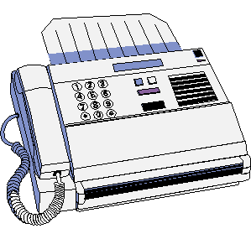


Current Process

Slide 8



Our System

Slide 9
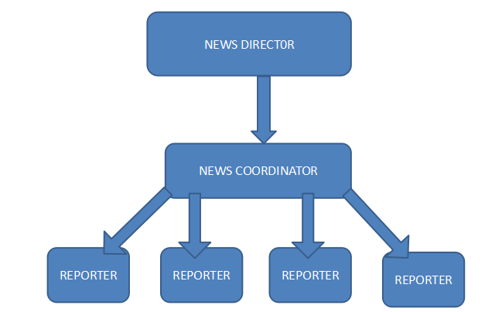
HIERARCHY DIAGRAM

Slide 10
Objectives
User friendly application to the provincial reporters
Convert the manual system into a standard computerized system
Minimize the unclear situations such as connection/signal problems when we are using telephone calls to co-ordinate.
Inform all the provincial reporters about the coverages and news of their area
Reporters also can inform about the news in their city to the head office
Inform others when someone has been assigned to a specific task
Web application to the co-ordinators to control the work flow

Slide 11
Functional requirements
Coordinator - Web Based System
1. Log in to the system
2. Send new news items to reporters
3. Receive news items from reporters
4. View pending news, scheduled news, monthly summary and reporter details
5. Send messages to reports

Slide 12
Functional requirements
Reporter – Mobile App
1. Log in to the system
2. Send news to the media corporation
3. View upcoming news, monthly news summary, inbox and monthly salary

Slide 13
Non-functional requirements
Usability
A user friendly interface for both web and mobile applications with an attractive UI.
Dependability
When you are entering something without data connection you’ll be sent a notification which says “You are not connected. Please check the connection ”.if you record something offline the database will be updated as soon as the person become online. And special notification will be sent to him stating that.
Availability
Even if there’s no connection the user have access to see his salary and upcoming events.

Slide 14
BENEFITS
Can share information effectively
Improve reporter relationship by news director with the news coordinator
Can access to the information anytime
Reporters can get notifications about their new tasks

Slide 15

ANALYSIS

Slide 16
TECHNICAL FEASIBILITY
Mobile application will run on any mid-range tablet or smartphone. Stylus is required to capture signatures.
Developing android applications are getting easier with hybrid technologies which uses HTML/CSS/JavaScript for development.
Technical aspects of the development are well within the group’s ability. Team is currently researching on a suitable technological stack to be used.
Web application will run on all major browsers which supports HTML5.

Slide 17
OPERATIONAL FEASIBILITY
The mobile application will provide simple and intuitive interfaces to the reporter.
System does not require any other hardware components other than a Smartphone, a server and a desktop machine.
Contract problems, so this system is ideal.

Slide 18
SCHEDULE FEASIBILITY
A timeframe is not a client requirement, however it is a course objective.
Number of work hours:
Weekdays = 4
Weekend = 2
Number of member = 6
Man-hours per week = (4+2) * 6 = 36
Estimated number of weeks = 42
Estimated total of man hours = 36 * 42 =1512

Slide 19
Development Methodologies
Agile Methodology – SCRUM
A faster development methodology
Can conduct SCRUM sessions which would resolve the issues which the team members would meet

Slide 20


Slide 21
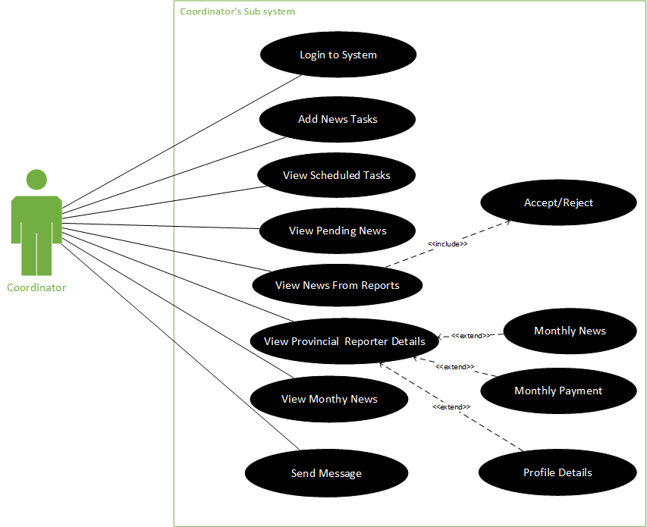

Slide 22
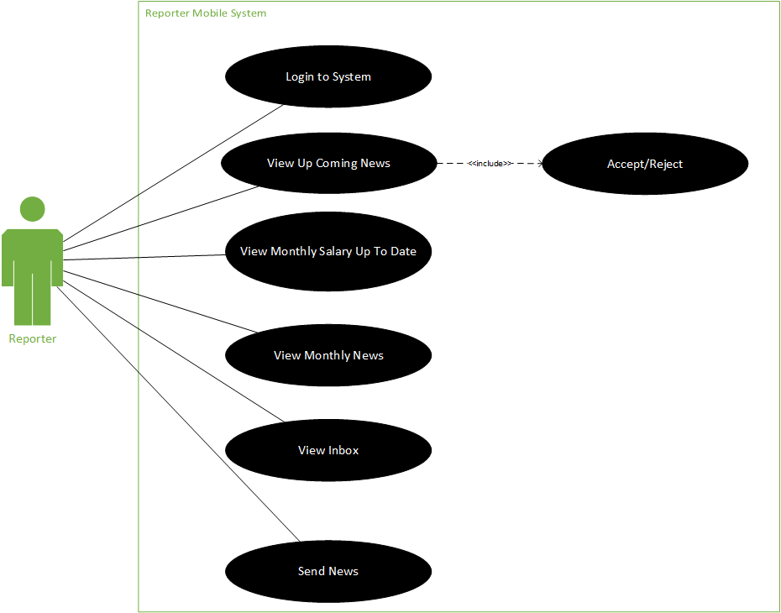

Slide 23



Technologies we use

Slide 24
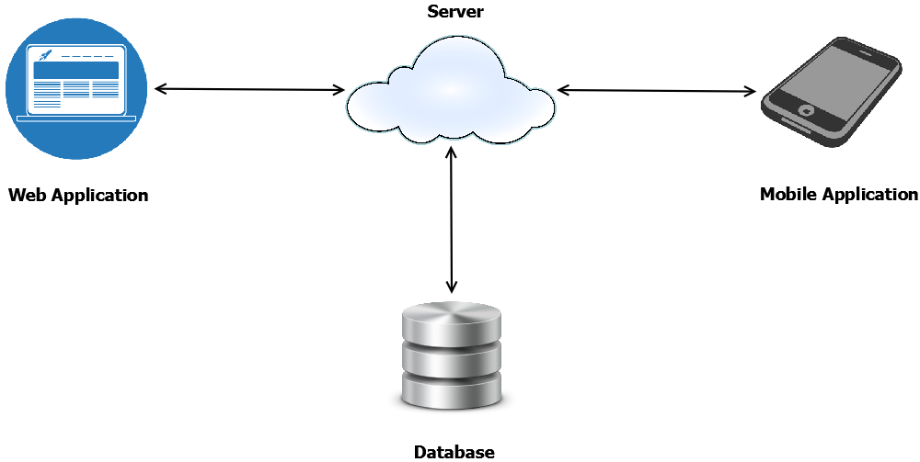
HIGH LEVEL ARCHITECTURE

Slide 25



DELIVERABLES
Web Application
Mobile Application
User Manual

Slide 26

Delivery Plan

Slide 27
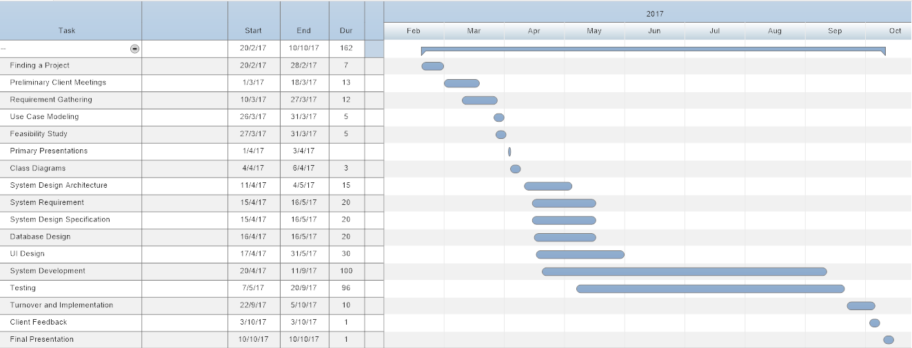
Gantt Chart

